Slide 1
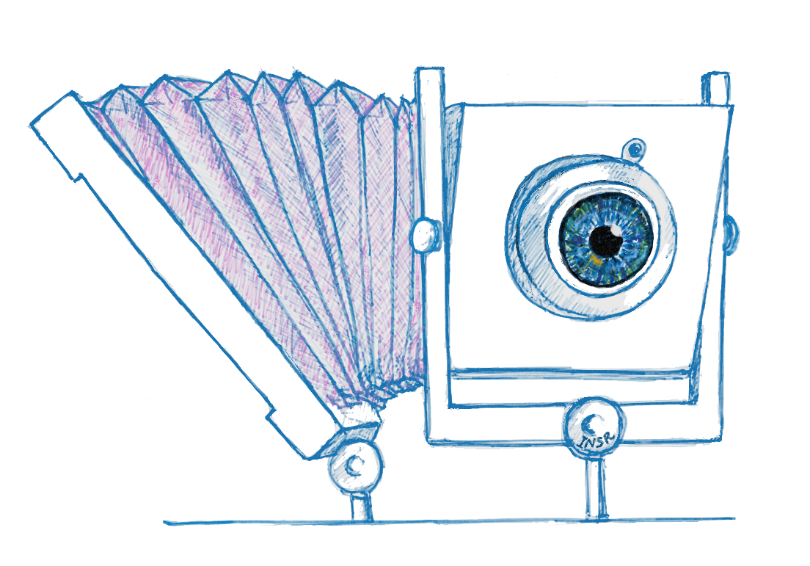
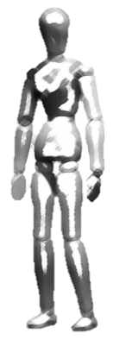
Scheimpflug with Computational Imaging to Extend
the Depth of Field of Iris Recognition Systems
Indranil Sinharoy
Committee:
Dr. Marc P. Christensen
Dr. Delores M. Etter
Dr. Dinesh Rajan
Dr. Panos Papamichalis
Dr. Yunkai Zhou

Slide 2
Notes:
[Blank?] There is need for security, and iris recognition could ….. But there is a problem.

Slide 3
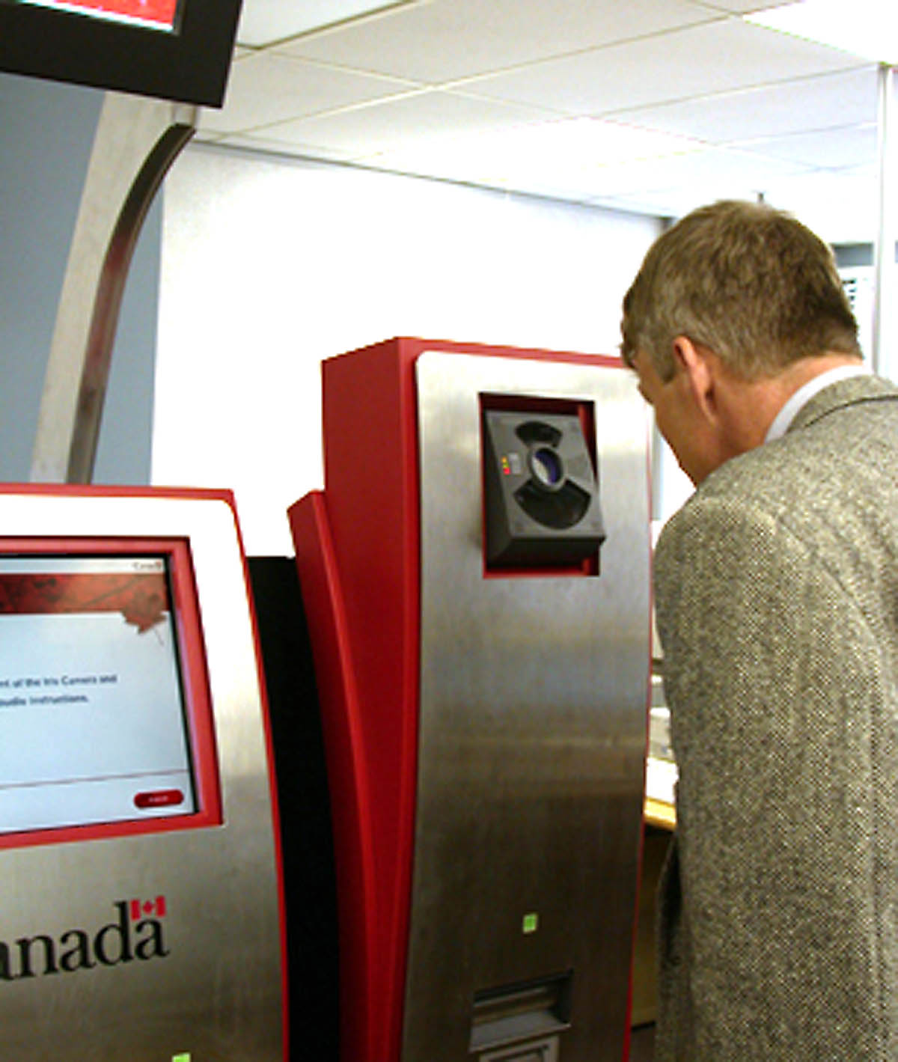
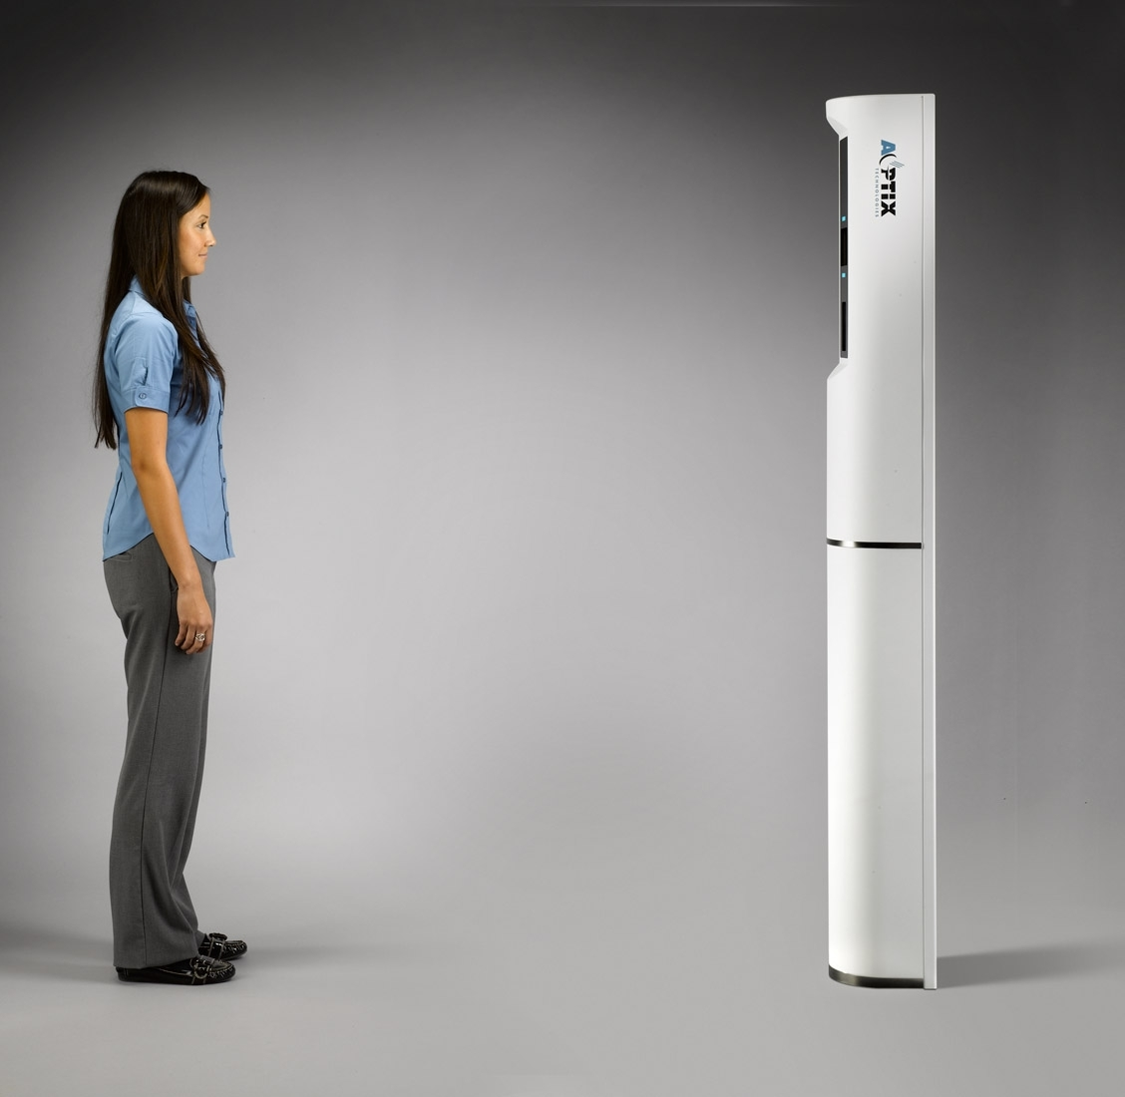
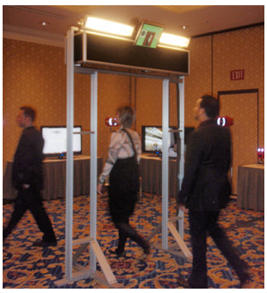
[CANPASS Air Iris Recognition System, biometricwatch.com, 2007]
[AOptix Technologies, Inc, asis.confex.com/asis/ansem2010/webprogram/Session24387.html]
[Hoyos Corp. & Stanley CSS demo., Photo by Geoff Kohl, Security InfoWatch, 2011]
Notes:
[Show picture of close range iris recognition and portal based iris recognition] … Despite the fact that iris recognition has been used successfully in close range and restricted environments, it has failed to gain wide scale adoption in large, open, unrestricted, public environments.

Slide 4
Notes:
State the goals here?

Slide 5
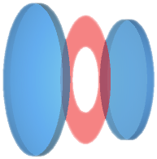
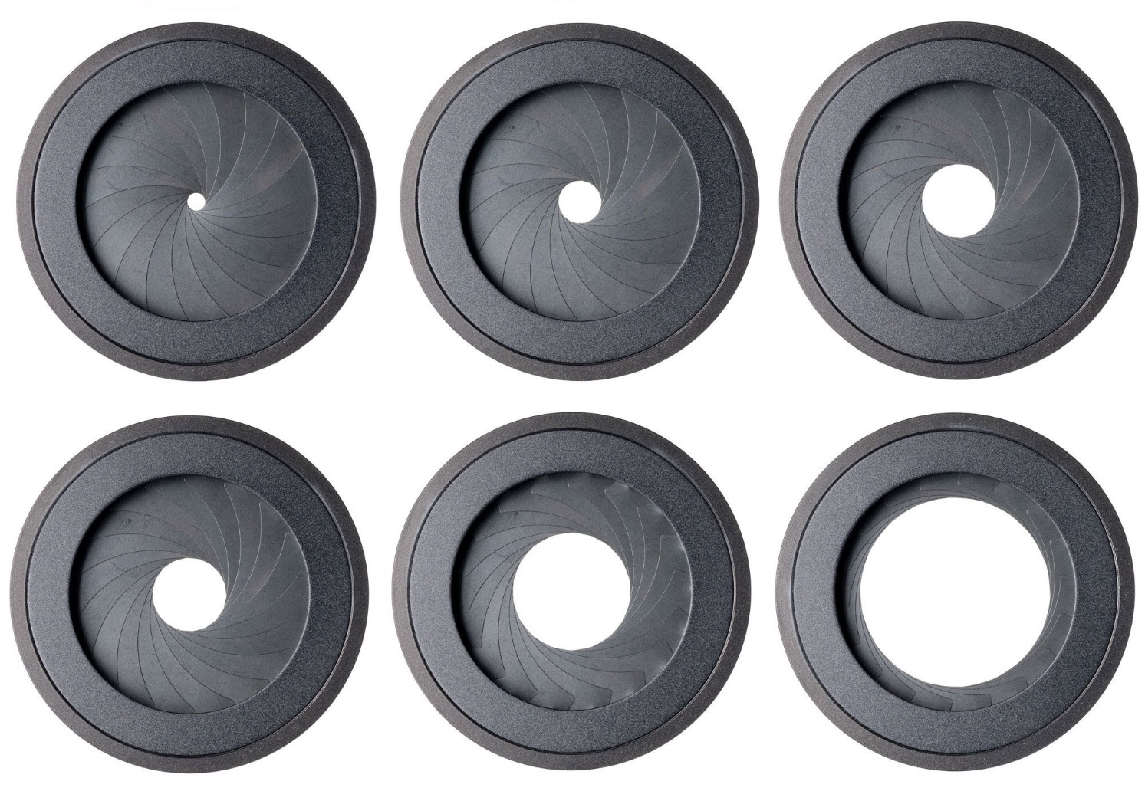

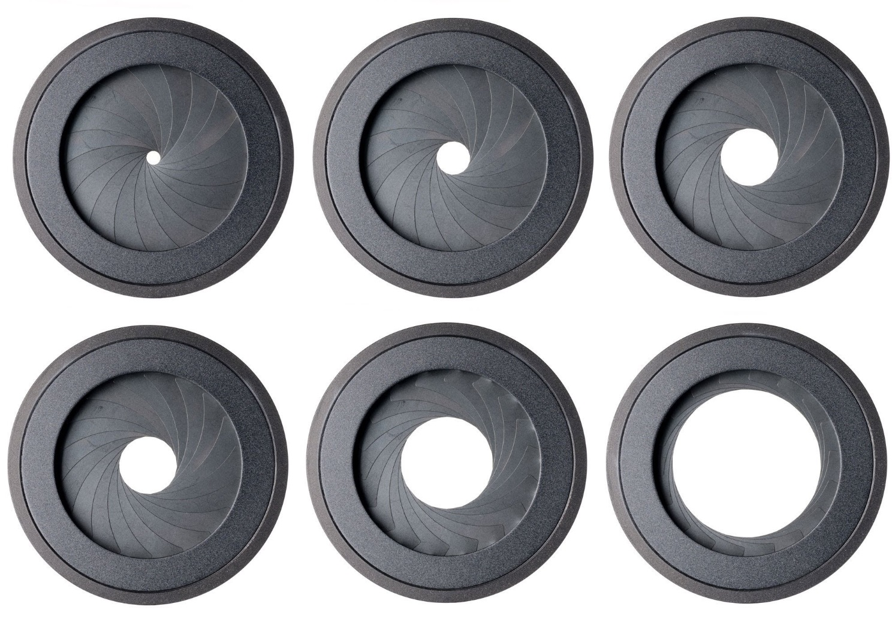
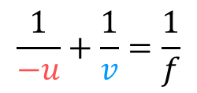

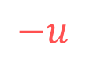
The depth of field (DOF) is the limited range of distances in the scene that appear sharp in the image
Lens elements
Aperture stop
Lens elements
Image plane
$$−u$$
$$v$$
DOF
$$\frac{1}{−u}+\frac{1}{v}=\frac{1}{f}$$
Plane of sharp focus (PoSF)
Gaussian formula:
Shallow DOF
Large DOF
F/5.6
F/8
F/11
F/16
F/22
Notes:
The Gaussian lens equation implies that only one plane in the object space can be in focus. I need to be very clear about mentioning that the F/# are ratios, the value depends on the diameter

Slide 6
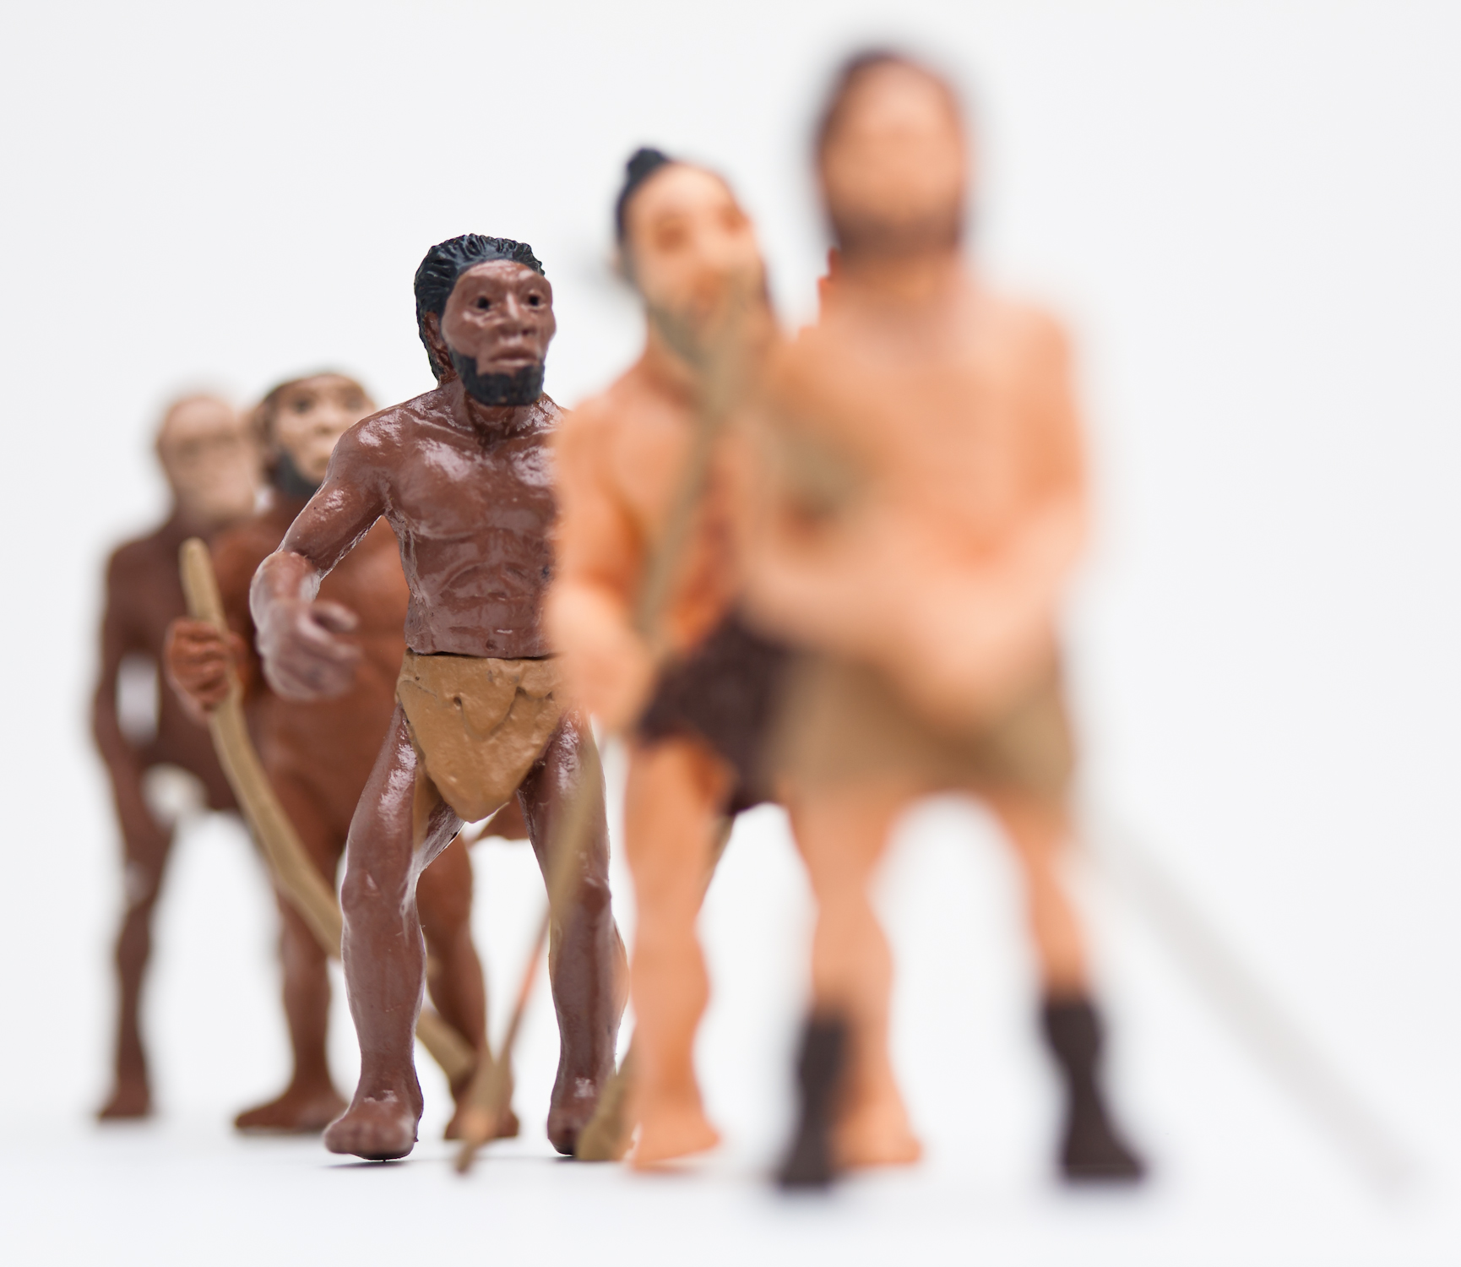
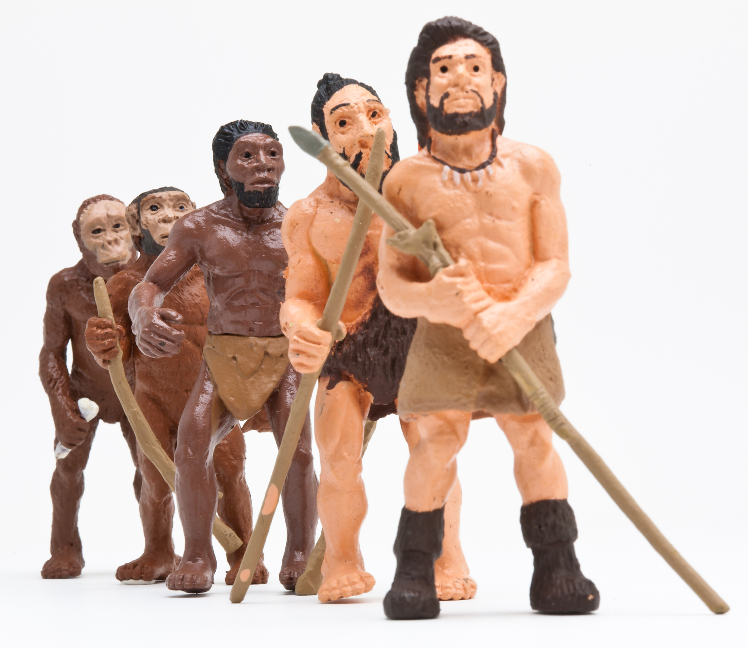
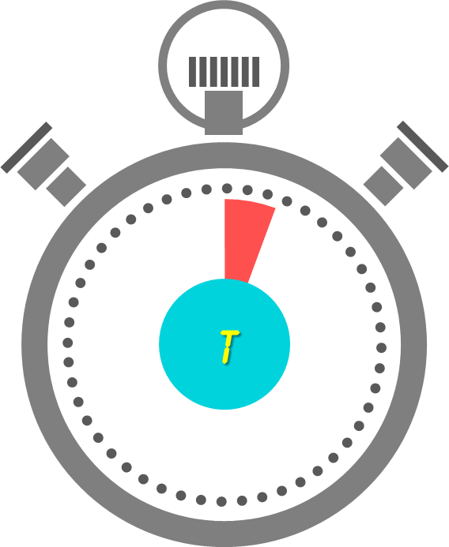
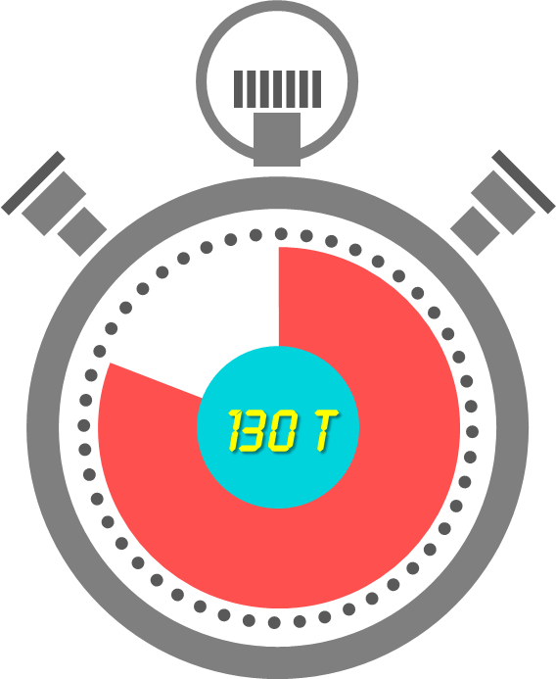
In traditional cameras the DOF is usually controlled by the aperture
Shallow DOF, aperture: F/2.8
Large DOF, aperture: F/32
Notes:
This is an example.
….
But if we can get a large DOF by using a smaller aperture, then why don’t we use a small aperture for extending the DOF of iris recognition systems?
There are a number of reasons, and here is one:
[[The clocks appear]]
It took over two orders of magnitude more time to capture the image on the right. While that’s probably OK for inanimate beings, (alt: while that is just fine for those whose time has run out ..) it is …..

Slide 7

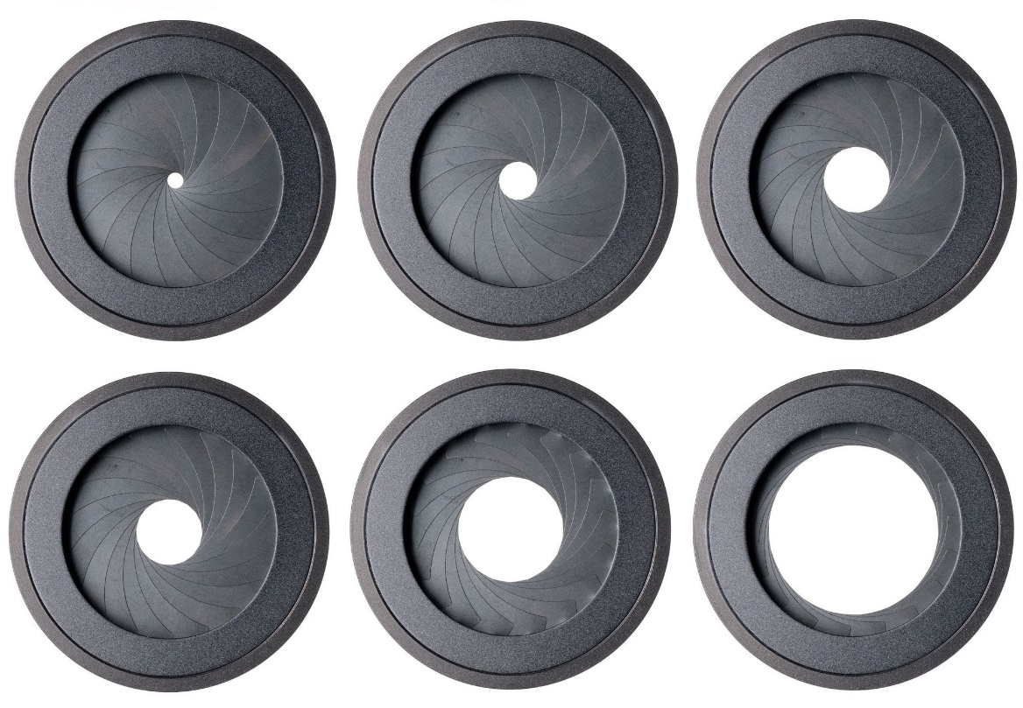




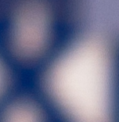
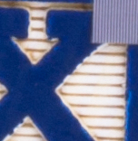
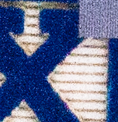
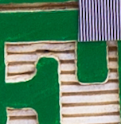
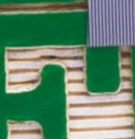
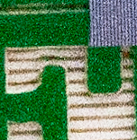

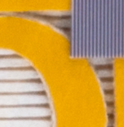
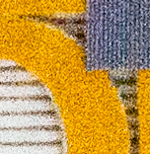
It is impossible to get high resolution, large DOF & high SNR simultaneously
in traditional imaging
Notes:
….therefore,

Slide 8
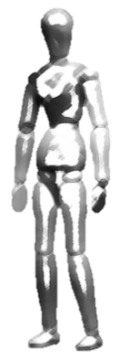
Demonstration of capture volume improvement using AFS in the laboratory
L
W
H
Standoff distance
Notes:
Explain the capture volume … how our approach suits our goals …. We are interested in increasing the axial capture volume …

Slide 9
Notes:
When we started looking into this problem, the first thing we did, as most researchers would do is look at the existing solutions.
Talk in brief about the existing solutions.
Talk about their disadvantages

Slide 10
Notes:
[Blank slide?]
After thinking about various ways to approach the problem, for example, using light field cameras, … we decided to invest on … scheimpflug princ…. Or using a scheimpflug camera.

Slide 11
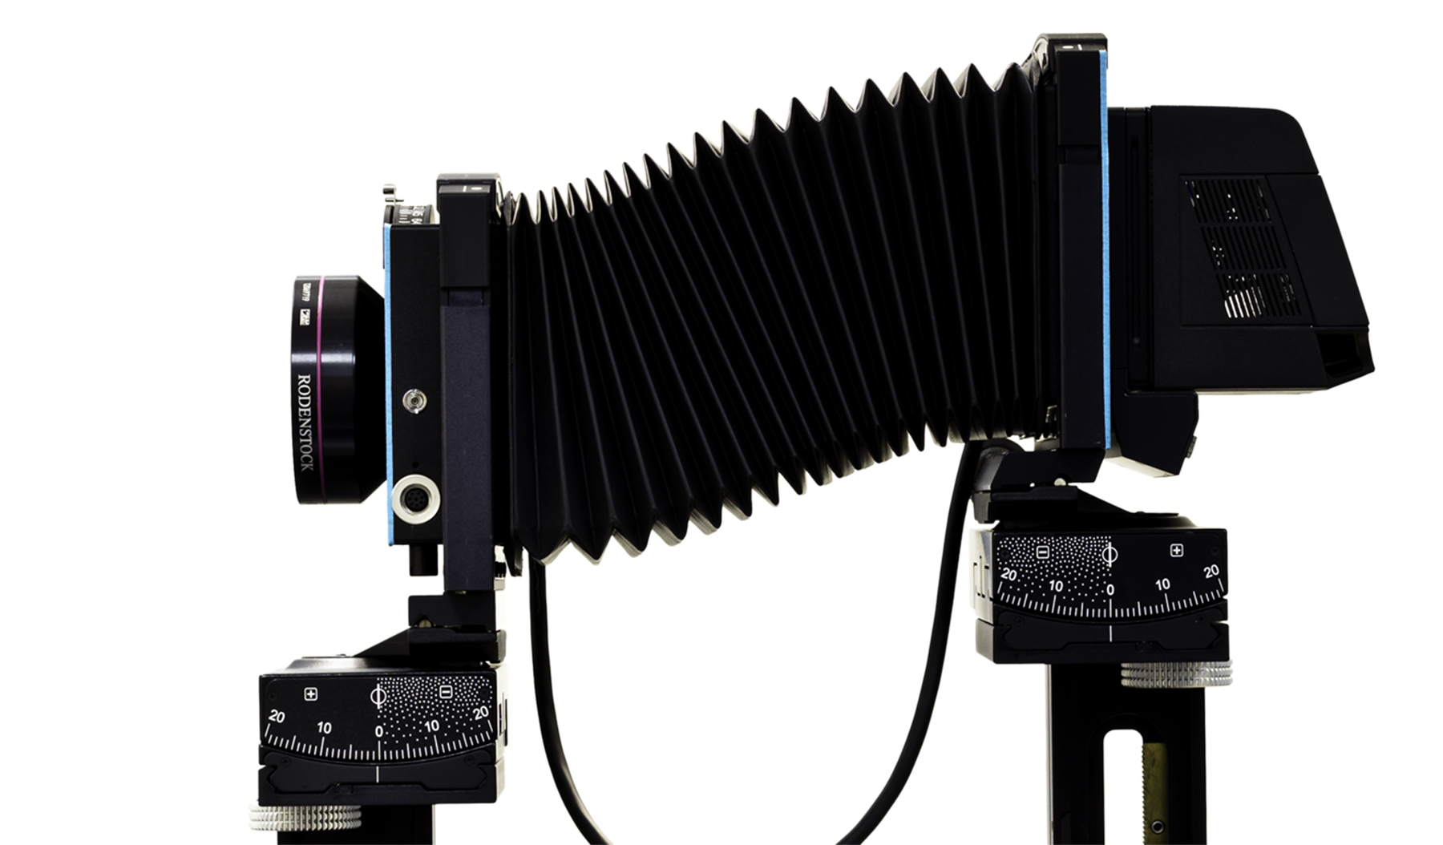
The lens & sensor in a Scheimpflug camera can rotate about independent pivots

Slide 12
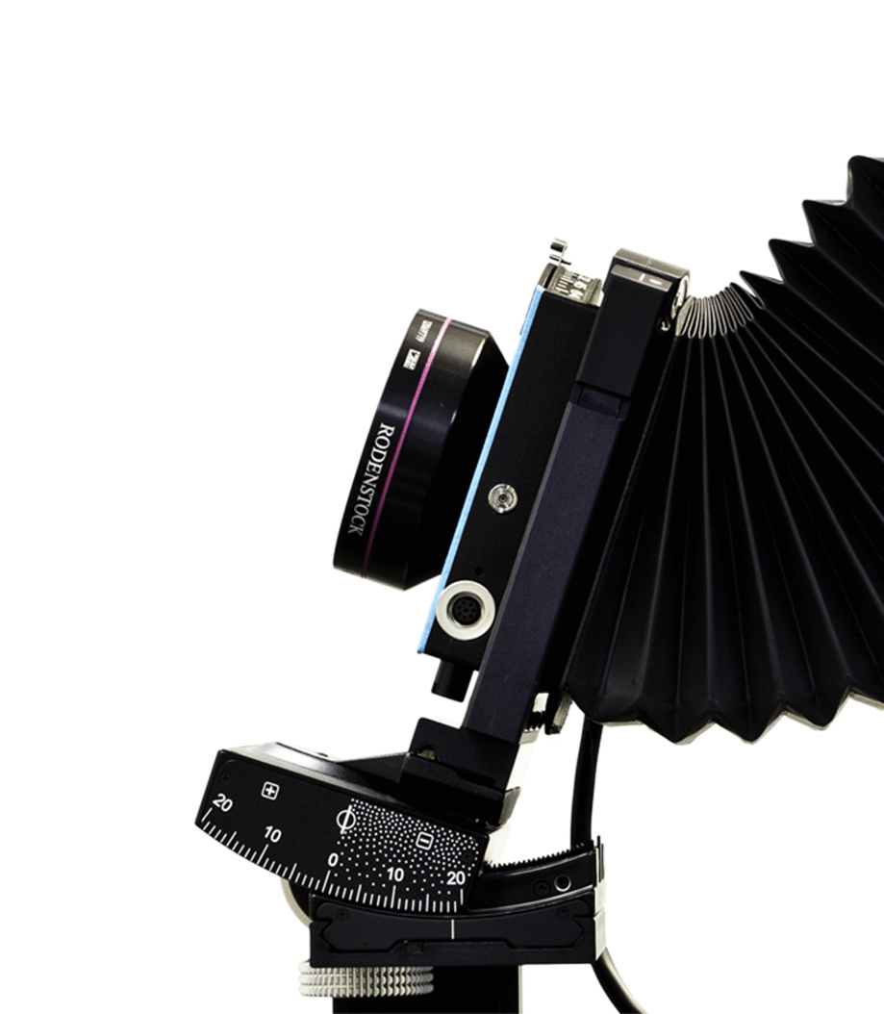
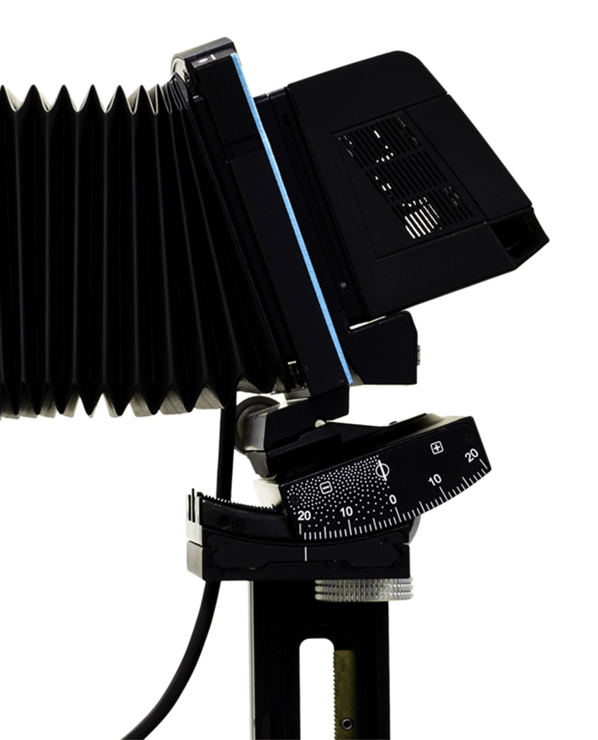
The lens & sensor in a Scheimpflug camera can rotate about independent pivots

Slide 13

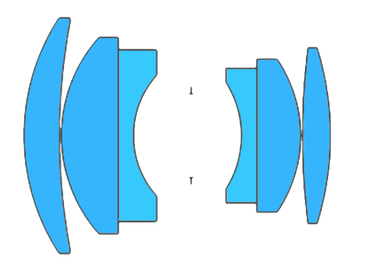
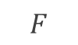
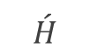
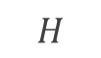
Scheimpflug principle: Rotating the lens or the sensor also rotates the plane of sharp focus
$$F$$
$$\acute{H}$$
$$H$$
Optical axis
Sensor
Plane of sharp focus (PoSF)
Depth of field (DOF)

Slide 14
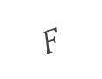
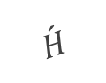
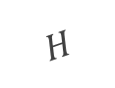
Scheimpflug principle: Rotating the lens or the sensor also rotates the plane of sharp focus
$$F$$
$$\acute{H}$$
$$H$$
Sensor
Depth of field (DOF)
Optical axis
Plane of sharp focus (PoSF)

Slide 15
Notes:
[Blank??] Bought a Sinar camera … did experiments …. Saw problems

Slide 16
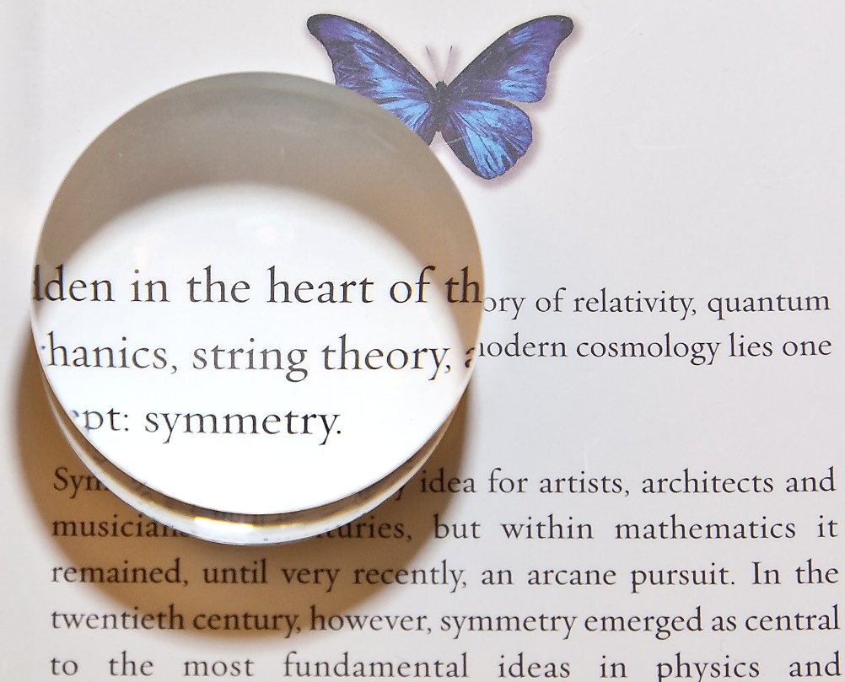
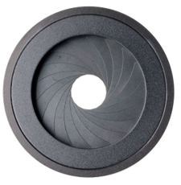
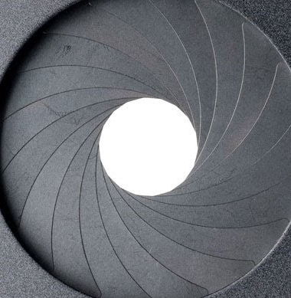
The “entrance pupil” is the image of the stop formed by the front lens elements
and the “exit pupil” is the image of the stop formed by the rear lens elements

Slide 17
Notes:
Explain pupil magnification

Slide 18
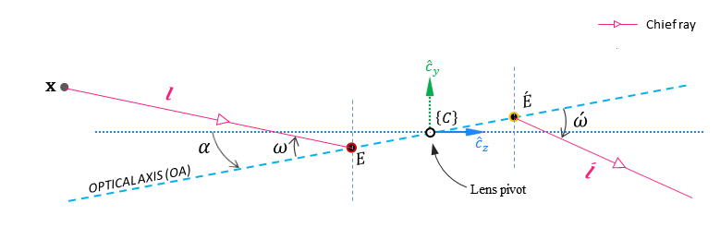
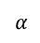
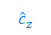


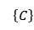
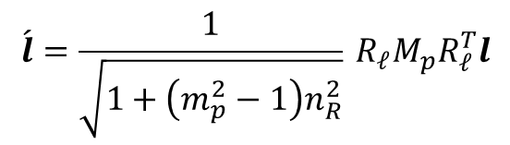
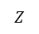
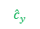

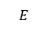
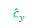
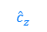
xxxxxx
Chief ray
$$\text{x}$$
$$l$$
$${\hat{c}}_{y}$$
$$\left\{C\right\}$$
$$\acute{E}$$
$$\acute{ω}$$
$$α_{ }$$
$$ω$$
$$E$$
$${\hat{c}}_{z}$$
OPTICAL AXIS (OA)
Lens pivot
$$\acute{l}$$
$$\acute{l}=\frac{1}{\sqrt{1+\left(m_{p}^{2}−1\right)n_{R}^{2}}}{}_{ }^{ }{R_{𝓁}}M_{p}R_{𝓁}^{T}l$$
Direction cosine of the chief ray in image space
Direction cosine of the chief ray in object space

